Slide 1

(Introduction to Environmental Studies) B. Tech 3rd Semester
Land Resources
Unit 2
Natural Resources
Department: Chemistry
Subject: Environmental Studies (CHM2041)

Slide 2
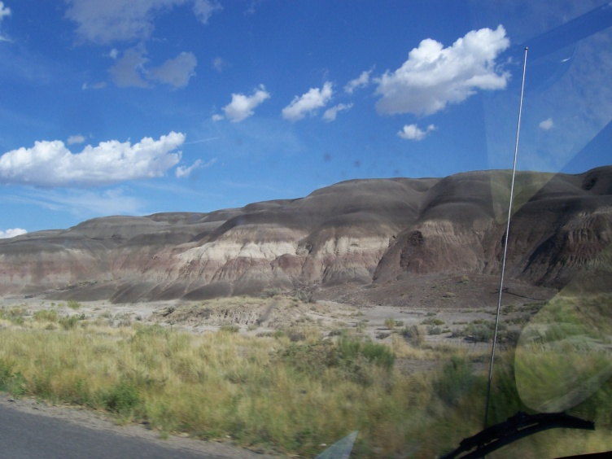
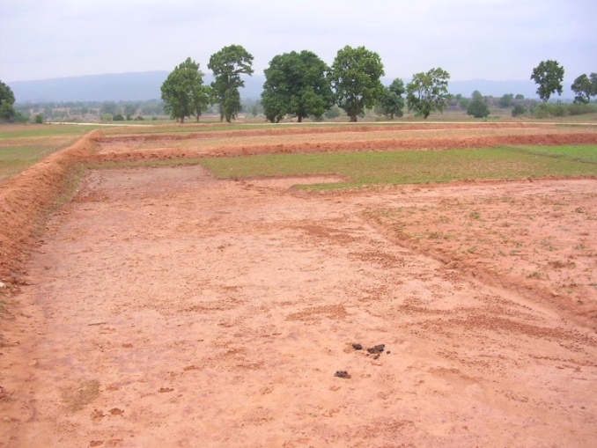
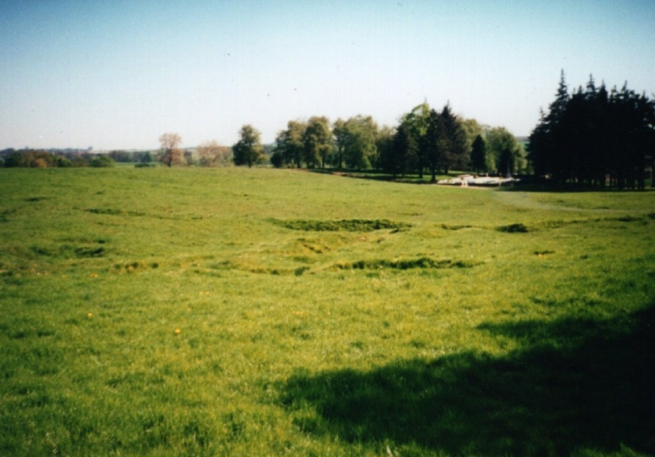
Land resources
Land is most simply defined as “the Solid portion of the Earth’s surface”.
It is a significant natural resource which plays an important role in the development of human society.

Slide 3
Importance of land as resource
Human civilization has taken shape on land
Fulfill the basic need of human civilization such as food, cloth and shelter
Used in agriculture
Acts as the store of basic resources like groundwater, minerals, and fossil fuels

Slide 4
Becomes a dump for solid and liquid waste
Protect from high temperature of earth’s core
Provide habitat for most of the flora and fauna
Even more Important, the top soil, just a few centimetres in thickness, supports all plant growth and is hence the life support system.

Slide 5
Soil Formation
“Soil is the dynamic natural body capable of supporting a vegetative cover”
Soil is largely composed of weathered rocks, along with water, oxygen and organic and inorganic materials or minerals.
Fertile soil generally contain high amount of organic matter
Functions of Soil
Significant role in nutrient cycles (carbon, Nitrogen etc.)
Basis of agricultural production
Store water and regulate water supply
Regulate emission of trace gases
Degrade pollutants and filter ground water
Produce most of clay for brick making
Provide a foundation for building (Used in construction)

Slide 6
Land Degradation
The fertility of land supports the growth and productivity of natural vegetation and agricultural crops.
A number of natural and man-made factors lower the quality of land. This is commonly referred to as land degradation.
Land degradation is the temporary or permanent lowering of the productive capacity of land

Slide 7
Causes of land degradation
Natural Causes:
Heavy rains lead to the removal of topsoil making soil infertile and hence unsuitable for agriculture
Natural disasters: Earthquake and floods can have considerable impact on land resources.
High–speed winds: Winds of high intensity and storms are responsible for land degradation: soil erosion ,etc….

Slide 9
Anthropogenic Causes:
Mining: generates a lot of waste that destroys vegetation and disrupts water circulation over large tracts, causes land degradation
Urbanization: The growing urbanization all over the world is major cause of concern
Deforestation: The indiscriminate and uncontrolled removal of trees have led to the destruction of forests.
Overgrazing: lowers soil quality and leads to land degradation
Dams and Canals: Construction of large dams and canals are also responsible for loss of vegetation leading to land degradation.
Fertilizers: Most of the chemical fertilizers used in modern Agriculture affect the productivity of soil and leads to land degradation

Slide 11
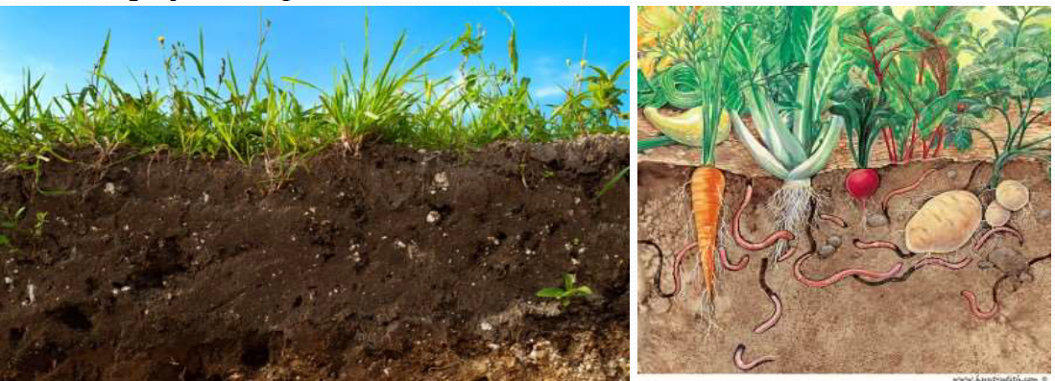
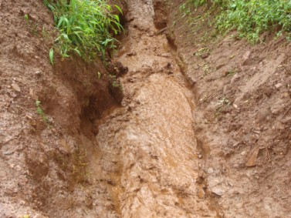
Soil Erosion
Soil erosion is removal of fertile or top soil from its resting place by various physical agencies like wind and water.
It can be defined as “the detachment and transport of the fertile layer of soil by water or air.”
It is also known as the creeping death of land.

Slide 12
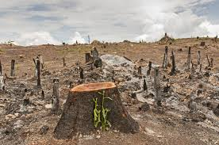
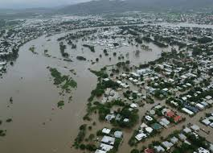
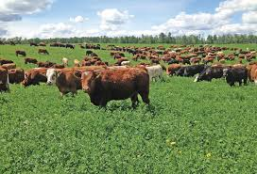
Causes of Soil Erosion
Large scale deforestation
Floods
Overgrazing
Large Violent Winds
Improper agricultural techniques

Slide 13
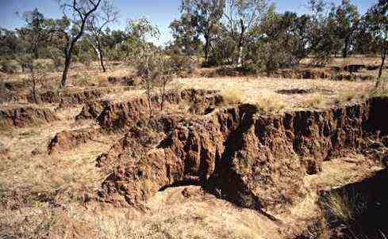
Effects of Soil Erosion
Decrease in productivity of land
Desertification of land
Reduction in the agricultural land at the banks of rivers
Deposition of soil in river beds and canals causing diversion of their natural flow and hence leading to disasters

Slide 14
Soil Conservation
It is extremely difficult for humans to control the natural factors of soil erosion.
(a) For Mild Slopes:
Reduced tillage (A cultivation operation whereby soil is disturbed as little as possible to produce a crop)
Stubble mulching
(b) For Gentle Slopes:
Contour bunding
Vegetative bunds
Contour cultivation
Strip cropping

Slide 15
(c) For Steeper Slopes:
Terracing
(d) Other methods
Afforestation on barren land
Control of overgrazing
Construction of small check dams
Promotion of equitable use of water resources
Prevention of excavation of rocks
Check Dams
Stop over grazing
A forestation

Slide 16
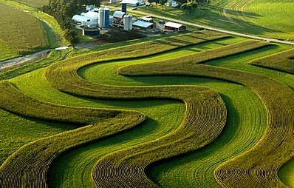
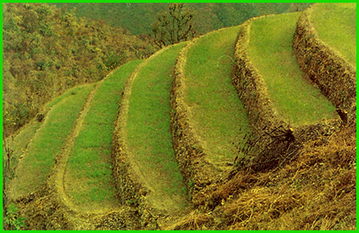
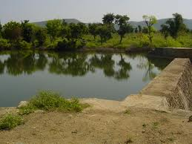
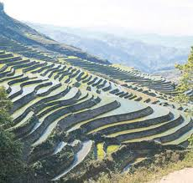

Soil Conservation
Strip cropping
Contour bunding
Construction of
small check dams
Afforestation
Terracing

Slide 17
LANDSLIDES
A landslide, also known as a landslip, is a geological phenomenon that includes a wide range of ground movements, such as rock falls, deep failure of slopes and shallow debris flows
A landslide is a downward or outward movement of soil, rock or vegetation, under the influence of gravity.
Three distinct physical events occur during a landslide: the initial slope failure, the subsequent transport, and the final deposition of the slide material
Various developmental activities like large dams reservoirs, construction of roads etc require large scale deforestation.
Landslides can occur in offshore, coastal and onshore environments.
The speed of the movement may range from very slow to rapid.

Slide 18
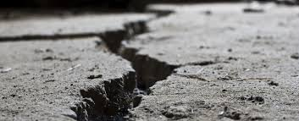
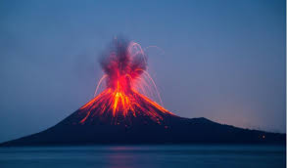
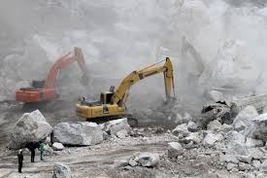
CAUSES OF LANDSLIDES
Heavy rains
Earthquakes
Volcano eruptions
Floods
Ground water changes
Rapid snow melt
Quarrying

Slide 19
EFFECTS AND LOSSES DUE TO LANDSLIDES
A) Direct Effects:
Physical Damage-Debris may block roads, supply lines (telecommunication, electricity, water, etc.) and waterways.
Causalities- deaths and injuries to people and animals.
B) Indirect Effects:
Influence of landslides in dam safety- failure of the slopes bordering the reservoir, Flooding caused by movements of large masses of soil into the reservoir.
Landslides and flooding- Debris flow can cause flooding by blocking valleys and stream channels, forcing large amounts of water to backup causing backup/ flash flood.

Slide 20
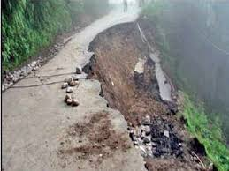
C) Direct losses:
Loss of life, property, infrastructure and lifeline facilities, Resources, farmland and places of cultural importance.
D) Indirect losses:
Loss in productivity of agricultural or forest lands, Reduced property values, Loss of revenue, Increased cost, Adverse effect on water quality and Loss ofhuman productivity, 14

Slide 21
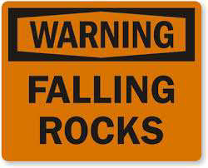
How to Minimize Landslide Hazards
Choose a safe location to build your home, away from steep slopes and places where landslides have occurred in the past.
Prevent deforestation and vegetation removal.
Avoid weakening the slope.

Slide 22
Plant ground cover on slopes and build retaining walls.
In mudflow areas, build channels or deflection walls to direct the flow around buildings.
Awareness generation: Educate the public about signs that a landslide is imminent so that personal safety measures may be taken.
Financial Mechanisms: Support the establishment of landslide insurance.
Legal and Policy: legislation to direct a governmental or private program to reduce landslide losses should be strengthened

Slide 23
Desertification
Conversion of fertile land into an infertile desert land is called desertification.
Causes of Desertification
Natural Factors
Very low rainfall
Excessive evaporation
Vast difference in diurnal temperature extremes
High salinity of soils
Anthropogenic Factors
Continuous cutting of trees
Overgrazing
Over irrigation
Excessive ploughing
Excessive use of fertilizers

Slide 24
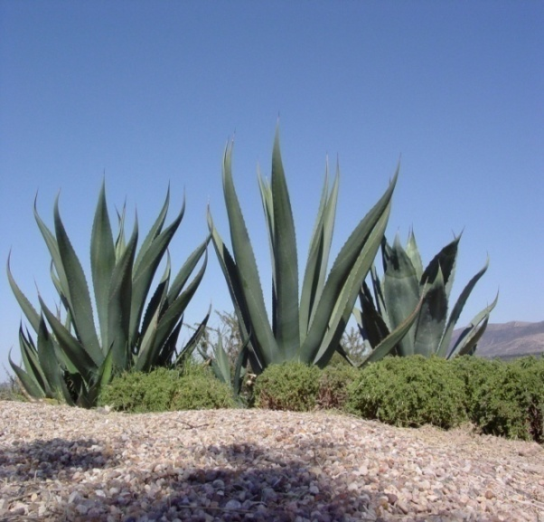
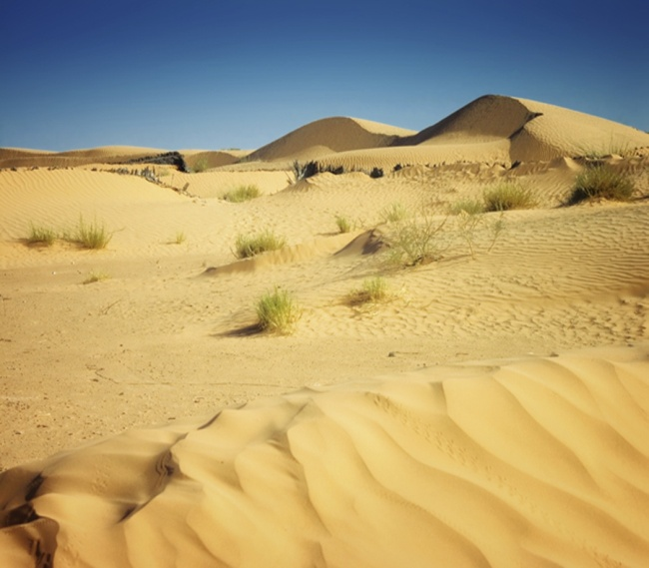
Effects of Desertification
Rapid soil erosion
Poor soil quality
Unfavorable climate
Low water table, salty
and hard water
Huge economic losses

Slide 25
Control of Desertification
Promoting large-scale plantation of trees
Changing agricultural practices and promoting dry land farming
Development of pasture (grassy) lands and control of overgrazing
Promoting equitable use of water resources
Development of water catchment areas

Slide 26


